Slide 1
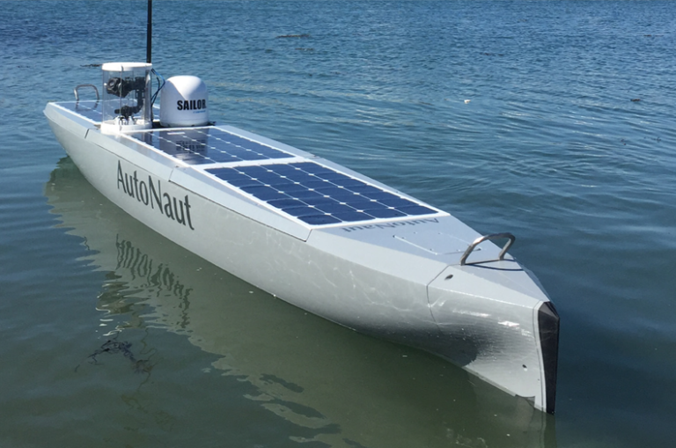
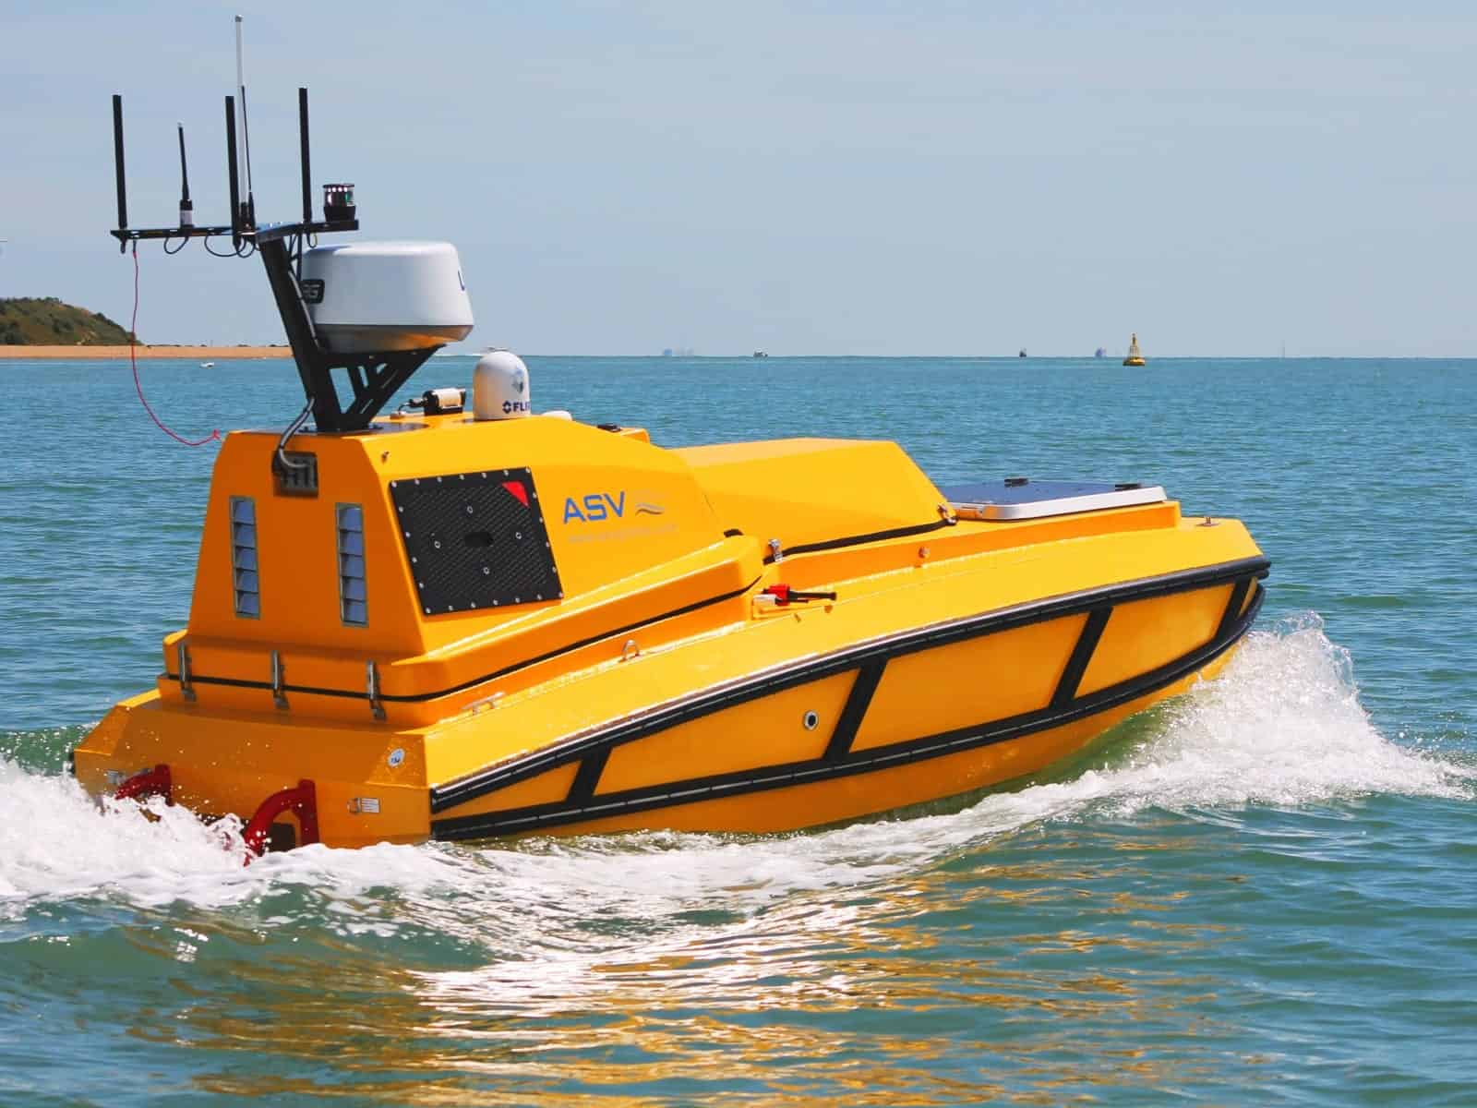
Obstacle Detection in USVs
Kovid Sharma
21ME01026
Under the Supervision of Dr. Yogesh Bhumkar and Dr. Debi Prosad Dogra
School of Mechanical Sciences
Indian Institute of Technology, Bhubaneswar

Slide 2
Content / Outlines
Introduction and Motivation
Literature Review and Literature Gap
Objectives and Methodology
Experimentation Details and Model Description
Results and Discussions
Conclusion and Future Scope
References

Slide 3
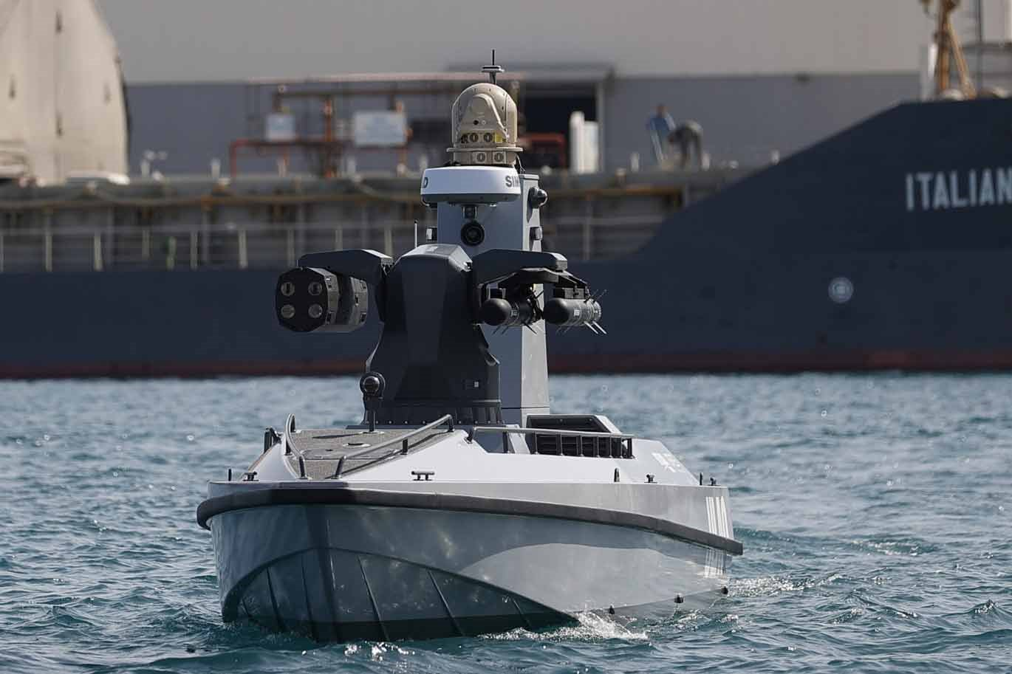
Introduction and Motivation
Unmanned Surface Vessels(USVs) are generally used in perimeter monitoring and surveillance tasks.
USVs can be navigated either through manual control or autonomously following a trajectory.
They come in various dimensions but usually less than 2 meters.
They are portable and can be easily navigated in narrow marinas.
In the majority of applications, they are required to navigate along a pre-determined path.
May be required to perform some tasks autonomously.
Fig. 1
Image credits: https://www.defenceprocurementinternational.com/features/maritime/are-unmanned-surface-vehicles-a-paradigm-shift-in-naval-warfare

Slide 4
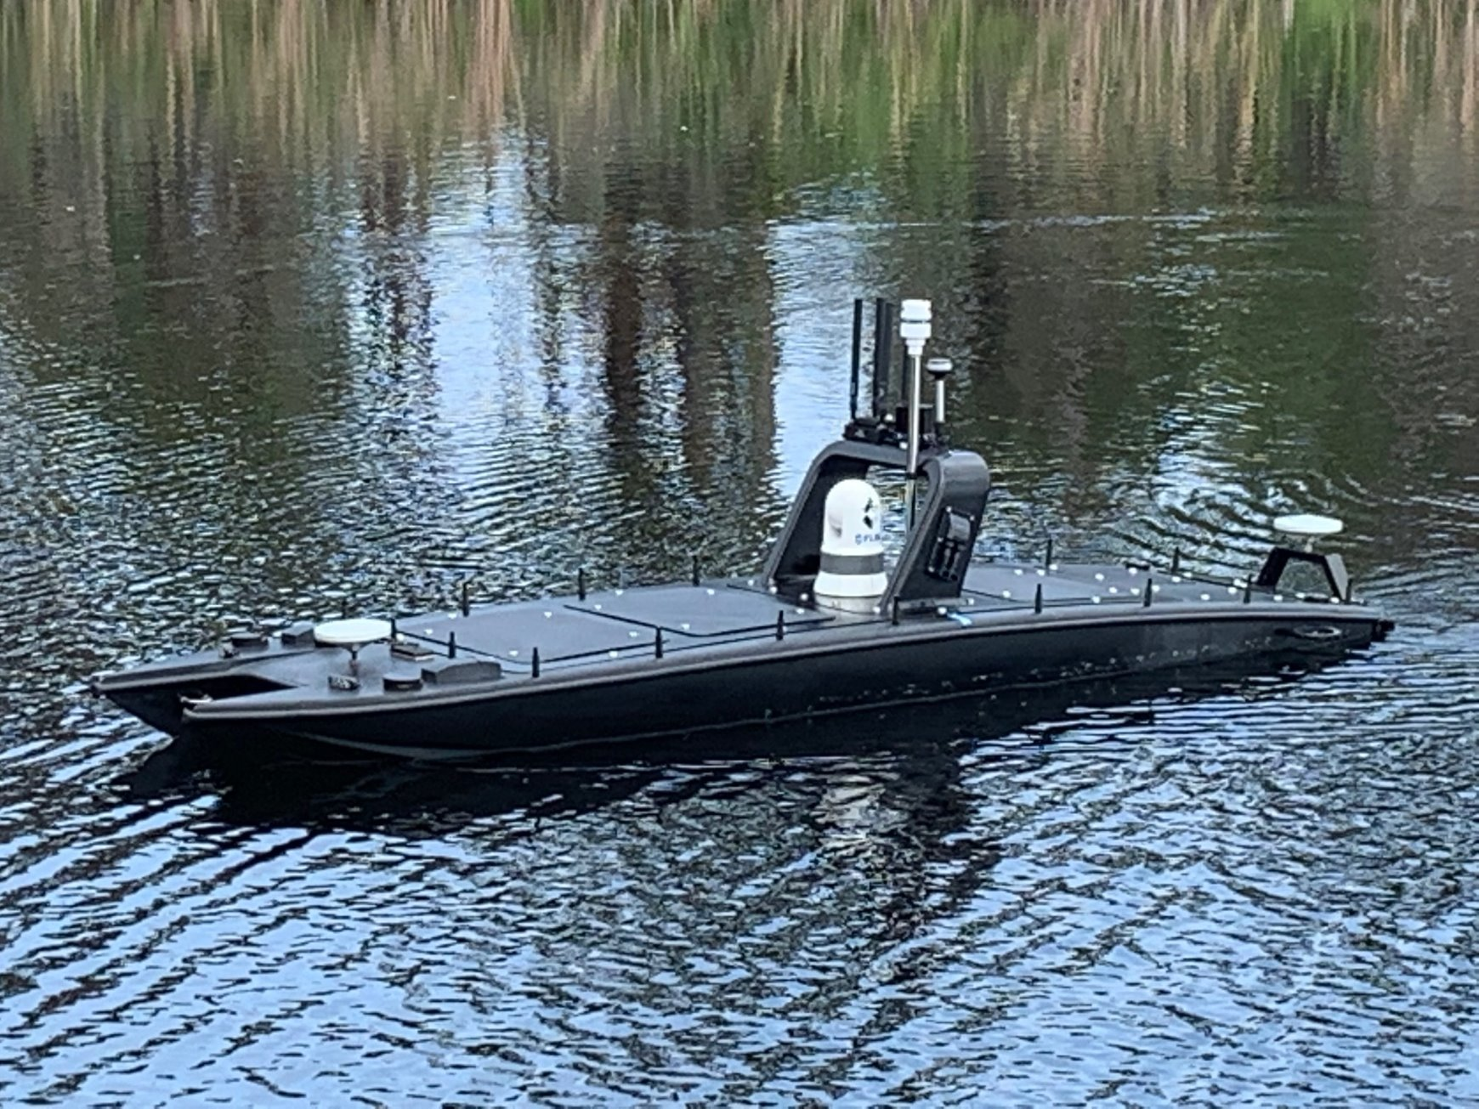
Introduction and Motivation
An autonomous system necessitates the use of an obstacle detection system and requires excessive computation.
Computation can be performed either at the ground station or via an onboard computing device.
Performing computation on the ground station and information transfer using telemetry limits the range of the USV.
For autonomous navigation, variety of sensors are used such as LiDAR, Sonar, Radar, Camera etc.
The compact size of the USVs constraints the power consumption and payload capacity which limits the use of sensors.
Fig. 2
Image credits: https://defense.info/defense-systems/unmanned-surface-vehicles-in-support-of-the-sustainment-mission/

Slide 5
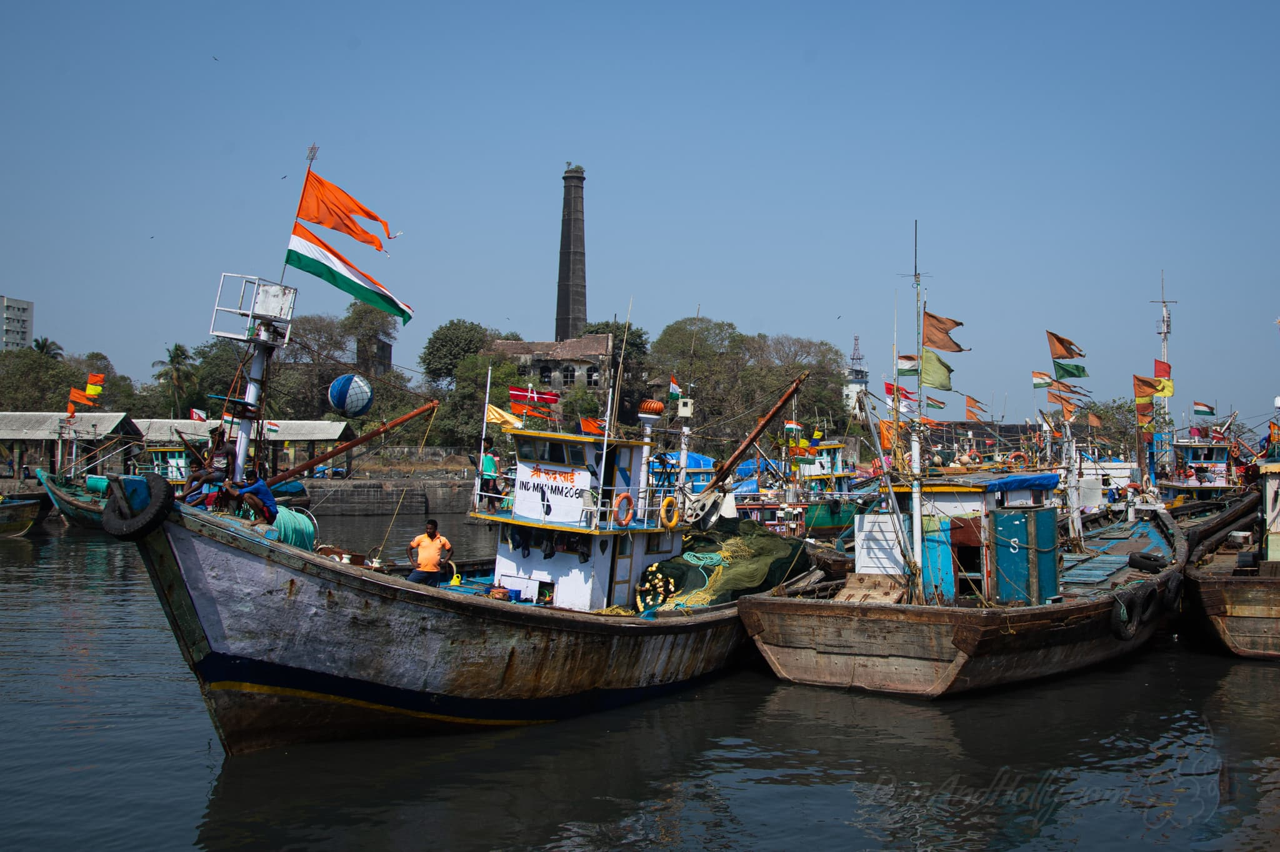
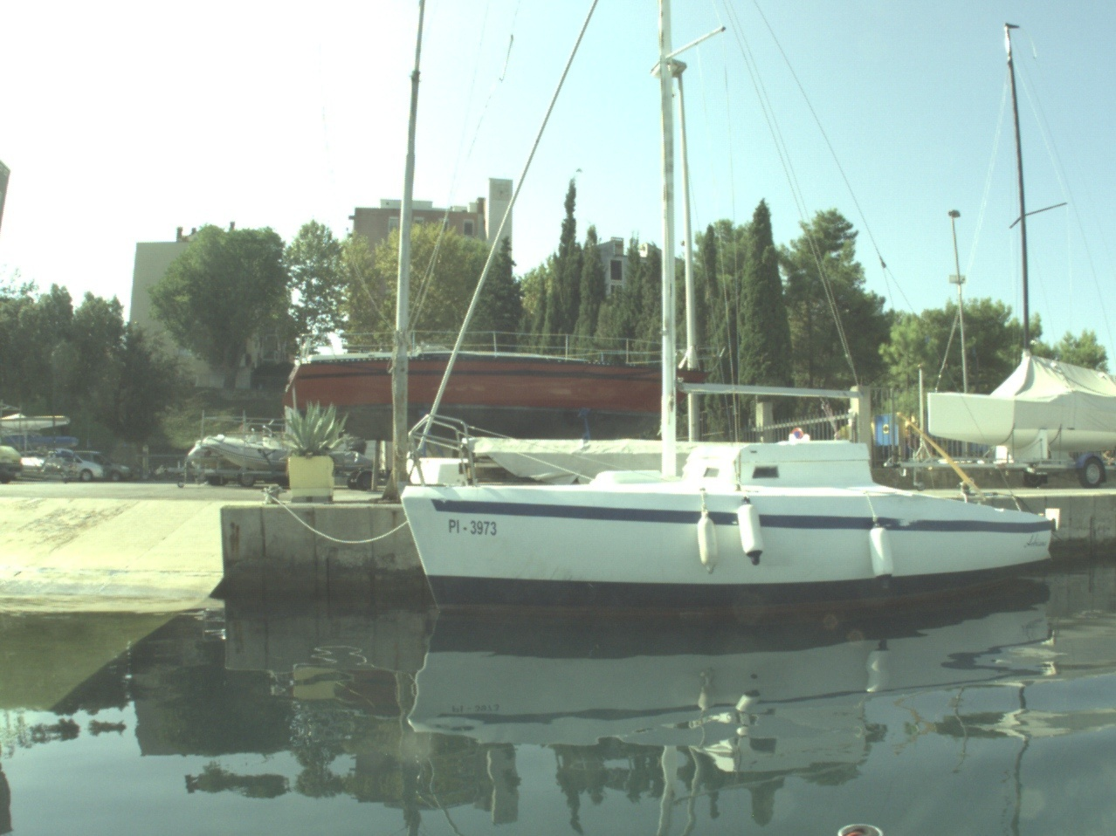
Introduction and Motivation
USV needs situational awareness to identify obstructions.
General obstructions in USVs scenarios are other vessels, people (Scuba divers), objects such as trash and most importantly the shoreline or water-edge line.
In certain instances (particularly those beyond India), satellite provides seashore maps^{[3]}
When combined with a GPS, enable the management of seashore obstacles.
No publicly available datasets of USVs for Indian Scenarios
Fig-3a
Image credits: https://danandholly.com/2021/01/indian-fishing-boats/
Fig-3b
Image taken from MODS dataset[21]

Slide 6
Literature Review and Literature Gap
Obstacle detection was previously addressed in the field of Unmanned Ground Vehicles (UGVs).
The research for it in USVs is still in the early stages.
Methods designed for UGVs cannot be easily applied to USVs for the following reasons:
They depend on estimating the ground plane. Not applicable to the underwater environment of USVs.
Maritime environment exhibit greater diversity as even a little submerged object pose a risk.
A lot of methods for detecting obstacles in marine environments is the use of range sensors like Radar, Sonar or LiDAR. Size and power restrictions.
Therefore, cameras combined with computer vision algorithms may be a promising alternative.

Slide 7
Literature Review and Literature Gap
Authors | Contribution
Larson et al.^{[4]} (2007) | Used a monocular camera and Estimated horizon using trigonometric calculations and nautical charts.
Gal, O.^{[5]} (2011) | Used edge detection approach to detect the horizon line. Assumed sea-edge as a straight line.
Wang et al.^{[6]} (2011) | Used pixel profile analysis and RANSAC regressor to estimate sea-sky line. Created a real-time obstacle detection system for a monocular and stereo camera system based on saliency detection
Most of these approaches approximate the edge of water by the horizon line.
In coastal scenarios, water-edge doesn't align with the horizon.

Slide 8
Literature Review and Literature Gap
Authors | Contribution
Kristan et al.^{[7]} (2015) | Introduced a graphical model for monocular obstacle detection by constrained semantic segmentation Partitions an image into three distinct and approximately parallel regions: sky, ground and water. Does not presume a straight water edge and operates in real-time Constructed the first large annotated dataset - MODD
Bovcon et al.^{[8, 9]} (2018, 2019) | Included sensor data like roll and pitch value from the Inertial Measurement Unit(IMU). Improved the segmentation model by introducing stereo verification. Constructed a new dataset with time-synchronizatized data streams – MODD2. Proposed another dataset MaSTr1325 which was per-pixel semantically labelled and a data augmentation protocol
Bovcon et al.^{[10]} (2022) | Proposed a large unified dataset – MODS for obstacle detection and estimate depth maps.

Slide 9
Literature Review and Literature Gap
Authors | Contribution
Ahmed et al.^{[11]} (2023) | Used a generative adversarial network(GAN) model for image de-hazing and de-noising. YOLOv5 based object detection system to detect objects from enhanced images.
Majority of approaches used are segmentation based and cannot give real time inference on Embedded GPUs.
Accuracy of the existing approaches will significantly vary when implemented in Indian Scenarios.
Deep learning-based object detectors have a significant potential for real-time obstacle detection.
There is no publicly available dataset for USVs that cater to Indian scenarios.

Slide 10
Objectives and Methodology
With this research, we plan to complete the following objectives:
To explore and experiment existing obstacle detection approaches in Indian scenarios.
To create an annotated dataset for Indian waters to boost the research in this field.
To develop a robust obstacle detection system that can work on an Embedded GPU.

Slide 11
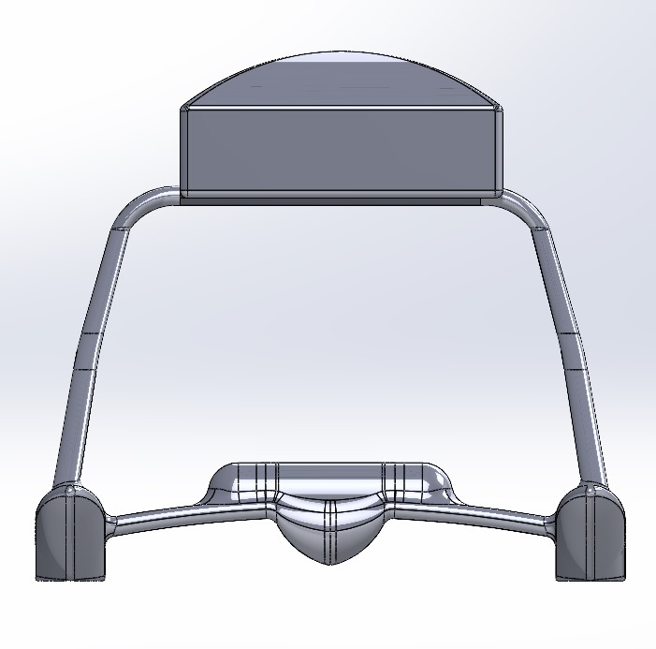
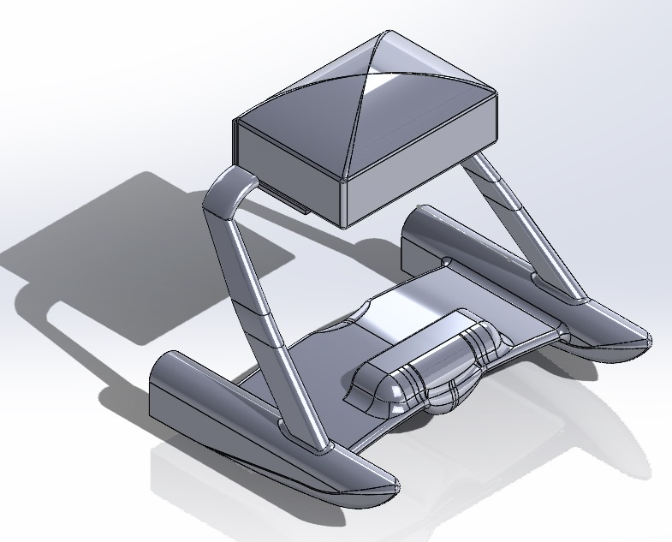
Objectives and Methodology
Methodology to be followed:
Experimentation with a multi-modal approach for obstacle detection. Semantic segmentation for detecting the water-edge and an object detection model to detect obstacles.
Exploring multiple segmentation and object detection models to test their real-time performance.
Since the USV in under development, we plan to experiment on the MODS^{[10]} dataset.
Developing an IMU – camera calibration system and employing an Embedded GPU. Testing the USV on various water-bodies.
Construct a dataset with visual and sensor data, and experiment with the models created.
Fig. 4: CAD Model

Slide 12
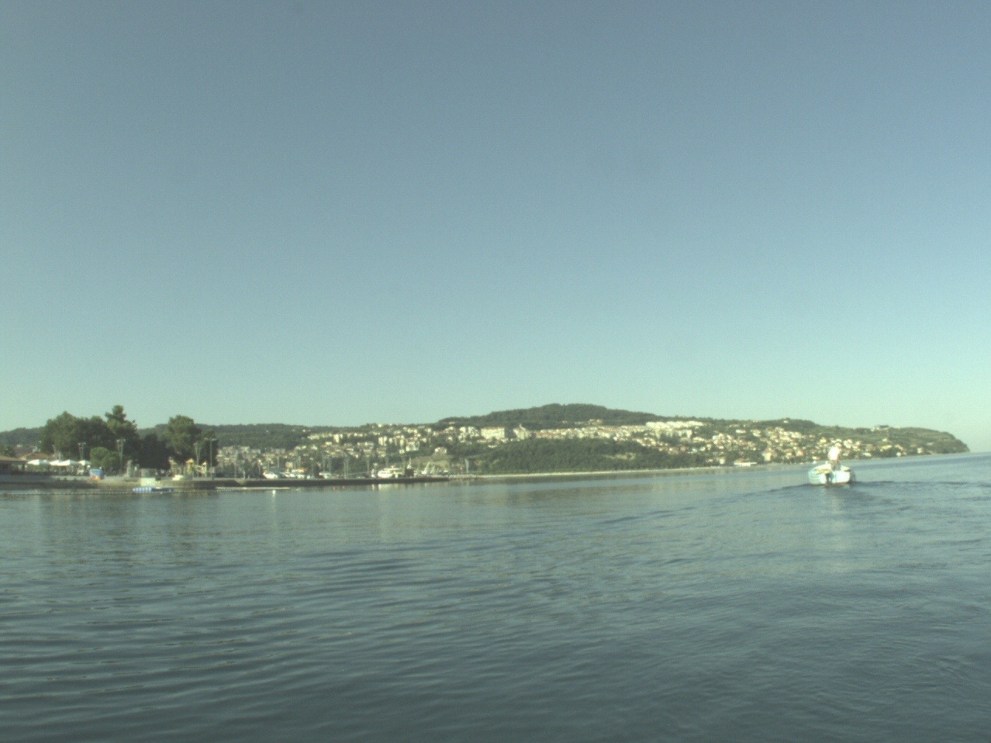
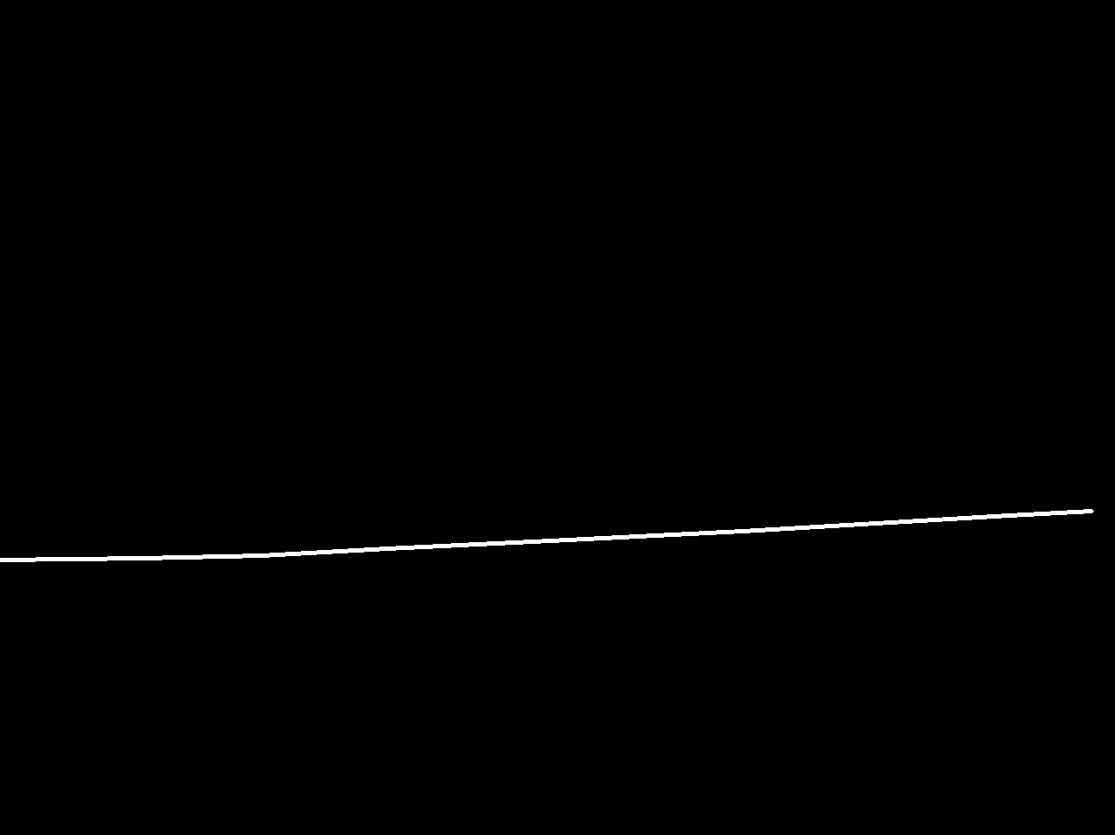
Experimentation Details and Model Description
Dataset Modification
Segmentation
The MODS dataset contained annotations in JSON format.
The dataset was modified for water-edge segmentation task and contains 8175 images.
Binary Masks of the images were created using OpenCV library.
The images were resized to 640 x 640 pixels for training.
Fig. 5: Image and its mask

Slide 13
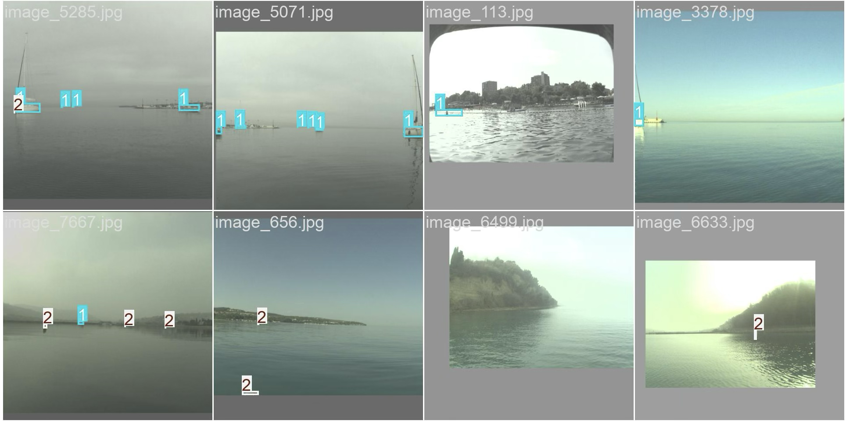
Experimentation Details and Model Description
Dataset Modification
Detection
Bounding Boxes format was changed to midpoint format.
[topleftx, toplefty, bottomrightx, bottomrighty]
to
[midpointx, midpointy, width, height]
The coordinates were re-scaled between 0 and 1 using image dimension.
The bounding boxes were then converted to TXT format
Fig. 6: Examples with bounding boxes

Slide 14
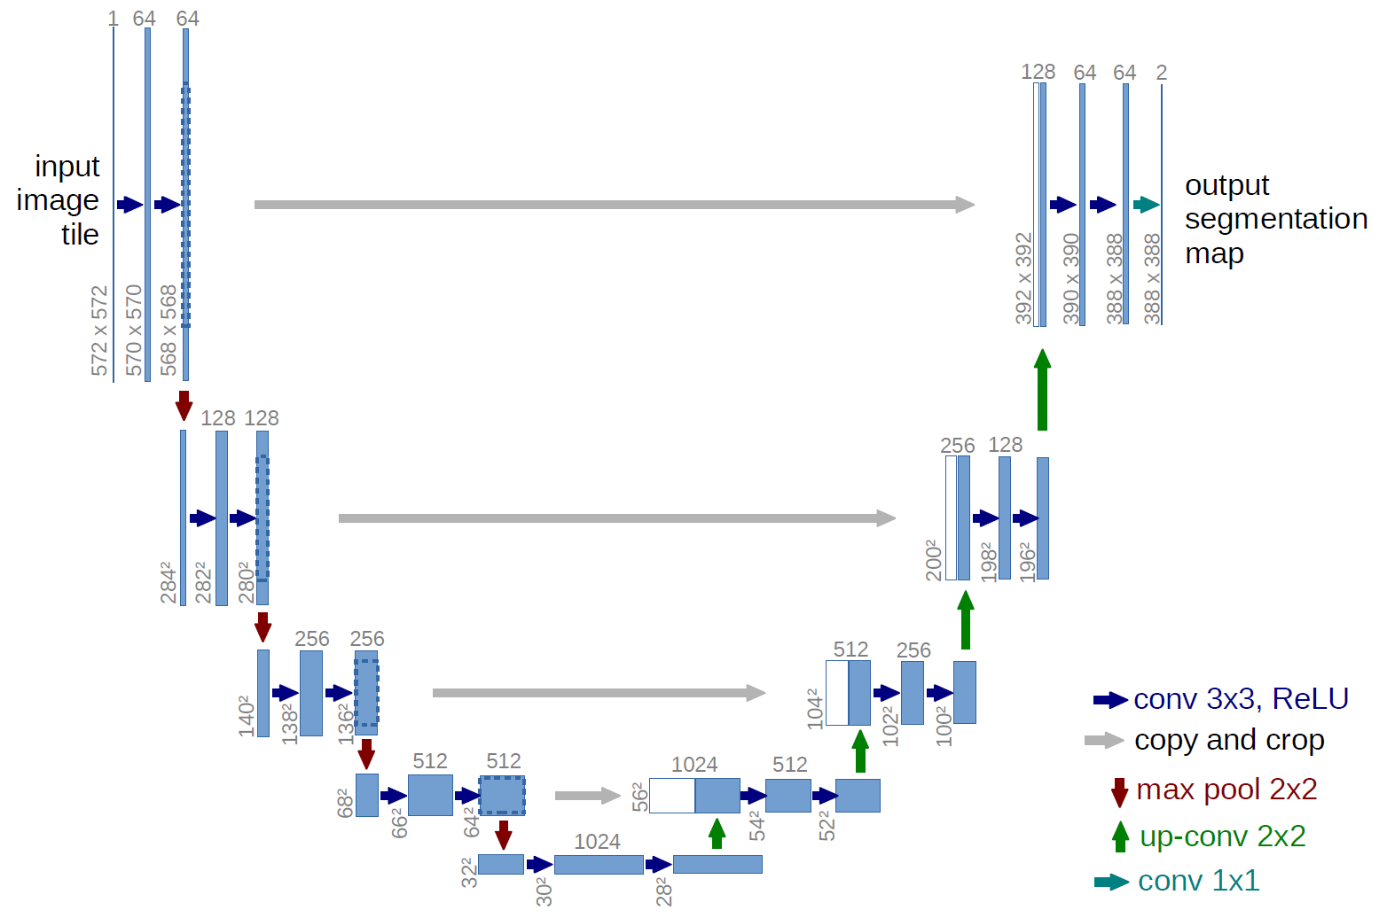
Experimentation Details and Model Description
Model Description
Vanilla U-Net
The model used for the segmentation task is a modified U-Net Architecture^{[12]}.
An input size of 640 is used instead of 572.
Batch Normalization layers are included to prevent overfitting.
Model was created using the PyTorch library and Python Programming language.
The final model contains 118,577,922 trainable parameters.
Fig. 7: U-Net Architecture^{[12]}

Slide 15
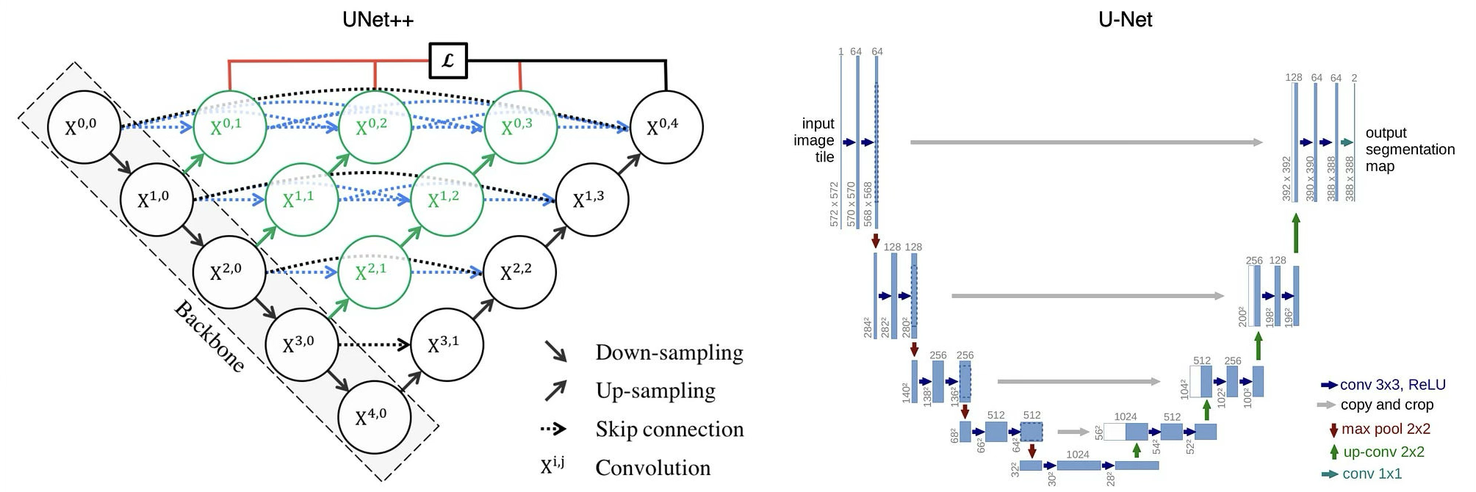
Experimentation Details and Model Description
Model Description
Models with custom encoders
All the models were created using Python, Pytorch framework, and Segmentation-Models-Pytorch library.
List of models and their specifications are mentioned in Table-1
Fig. 8: U-Net++ Architecture

Slide 16
Experimentation Details and Model Description
Table-1: Model Specificaions(Custom Encoder)
Encoder | Decoder | Model Size(Million) | Model Tag
ResNet18 | U-Net | 19.834 | res-unet
ResNet18 | U-Net++ | 21.753 | res-unet++
ResNet18 | PSPNet | 11.329 | pspnet-resnet18
ResNet18 | LinkNet | 11.663 | linknet-resnet18
ResNet18 | MANet | 28.001 | manet-resnet18
MobileNetv2 | U-Net | 13.388 | mobnet-unet
EfficientNet-b2 | U-Net | 14.746 | eff-unet
EfficientNet-b4 | PSPNet | 17.614 | pspnet-effnet-b4
EfficientNet-b4 | LinkNet | 17.862 | linknet-effnet-b4
EfficientNet-b4 | MANet | 31.276 | manet-effnet-b4

Slide 17
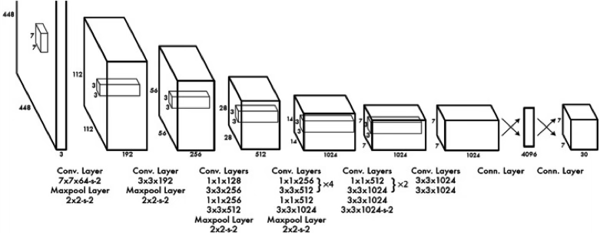
Experimentation Details and Model Description
Model Description
Object Detection
YOLOv8 and RT-DETR are trained for the object detection task
Both models are State-of-the-art and perform well in real time
Fig. 9: YOLOv1 Model Overview

Slide 18
Experimentation Details and Model Description
Experimentation Details
Vanilla U-Net
Model was trained for 4 hours and in total 25 Epochs.
Two NVIDIA T4 GPUs provided by kaggle are used parallelly.
The loss-function used in Binary cross entropy with logits loss.
Optimizer used is the Adam Optimizer.
The learning rate schedule can be seen in table-2
Data Augmentations were applied using the albumentations library.
Epoch No. | Learning Rate
1-10 | 0.001
11-15 | 0.0001
16-20 | 0.00001
21-25 | 0.000001
Table-2: Learning Rate Schedule for vanilla u-net

Slide 19
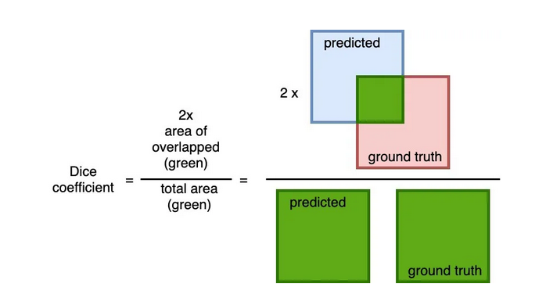
Experimentation Details and Model Description
Experimentation Details
Segmentation models with custom encoders
Training Setup - NVIDIA A10 GPU provided by the AI, Data Analytics and IoT Lab, SECS, IIT Bhubaneswar.
The loss-function used is dice loss. It measures the overlap between predicted and ground truth.
Optimizer – Adam Optimizer
The learning rate schedule can be seen in table-3
Data Augmentations were applied using the albumentations library.
One model was also trained for 30 Epochs to check convergence.
Epoch No. | Learning Rate
1-5 | 0.0001
6-10 | 0.00001
11-15 | 0.000001
Table 3: Learning Rate Schedule for custom models
Fig. 10: Dice Coefficient
Image credits: https://cvinvolution.medium.com/dice-loss-in-medical-image-segmentation-d0e476eb486

Slide 20
Experimentation Details and Model Description
Experimentation Details
Object Detection
Training Setup - NVIDIA A10 GPU provided by the AI, Data Analytics and IoT Lab, SECS, IIT Bhubaneswar.
IoU Threshold = 0.7, learning rate = 0.01, optimizer = Adam
The training details are mentioned in Table 4
Table-4: Object Detection Training Details
Model Name | Model Size(Million) | Training Epochs | Batch Size
Yolov8 | 43.69 | 100 | 32
RT-DETR | 32.97 | 50 | 24

Slide 21
Results and Discussions
Vanilla U-Net achieved a dice score of 0.68. MANet with EfficientNet-b4 backbone achieved a dice score of 0.66 with 3.8 times fewer parameters
Dice score > 0.8, considered good.
Yolov8 achieved 0.698 AP50 and 0.3612 AP95.
RT-DETR achieved 0.6718 AP50 and 0.3753 AP95
The AP scores are good but the confusion matrix tells a different story.
The results and loss curves can be seen in next slides.

Slide 22
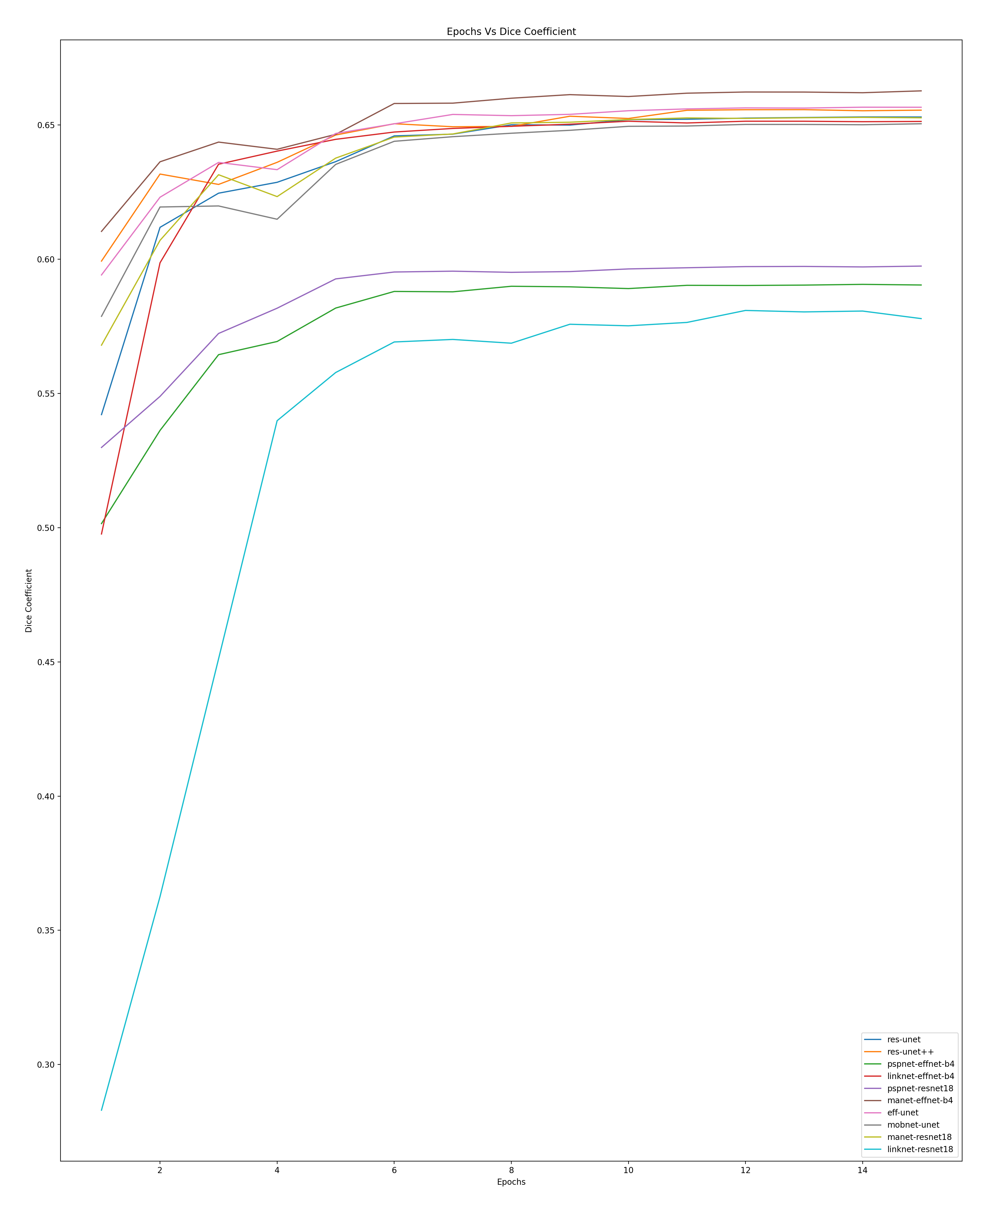
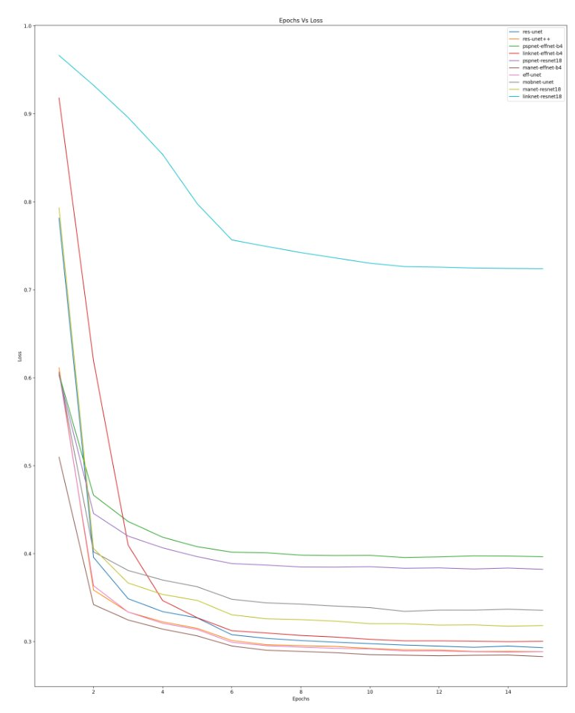
Results and Discussions
Fig. 11a: Segmentation Dice Curve
Fig. 11b: Segmentation Loss Curve

Slide 23
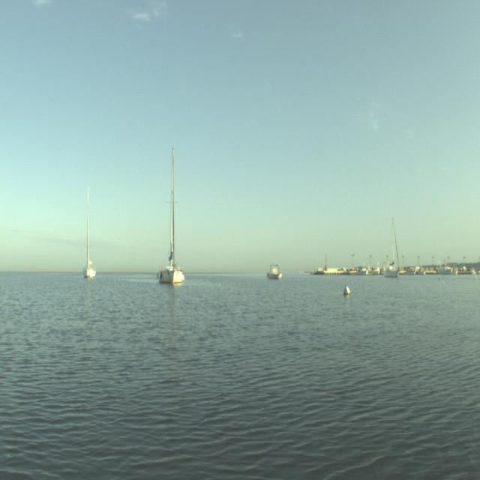
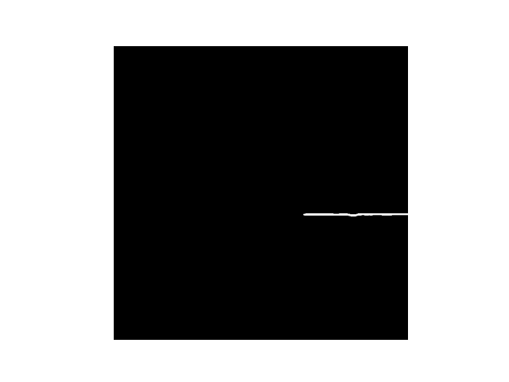
Results and Discussion
Input Image
Ground Truth Mask
Predicted Mask
Fig. 12a: Segmentation Results

Slide 24
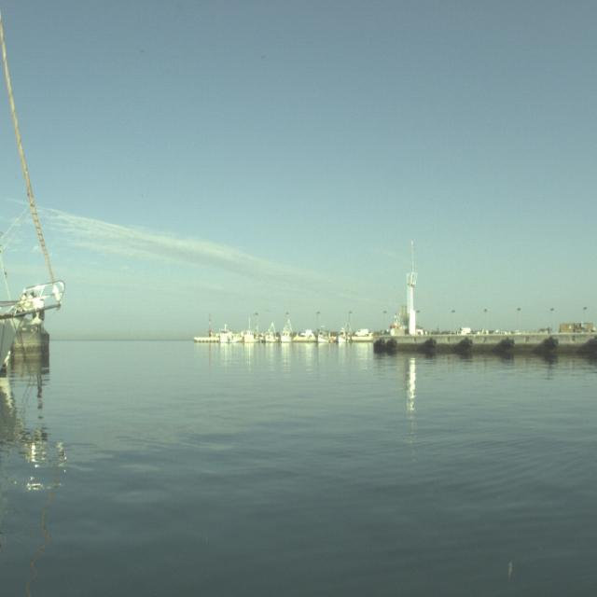
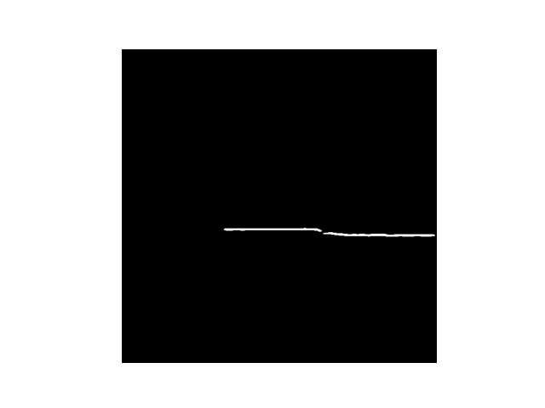
Results and Discussion
Input Image
Ground Truth Mask
Predicted Mask
Fig. 12b: Segmentation Results

Slide 25
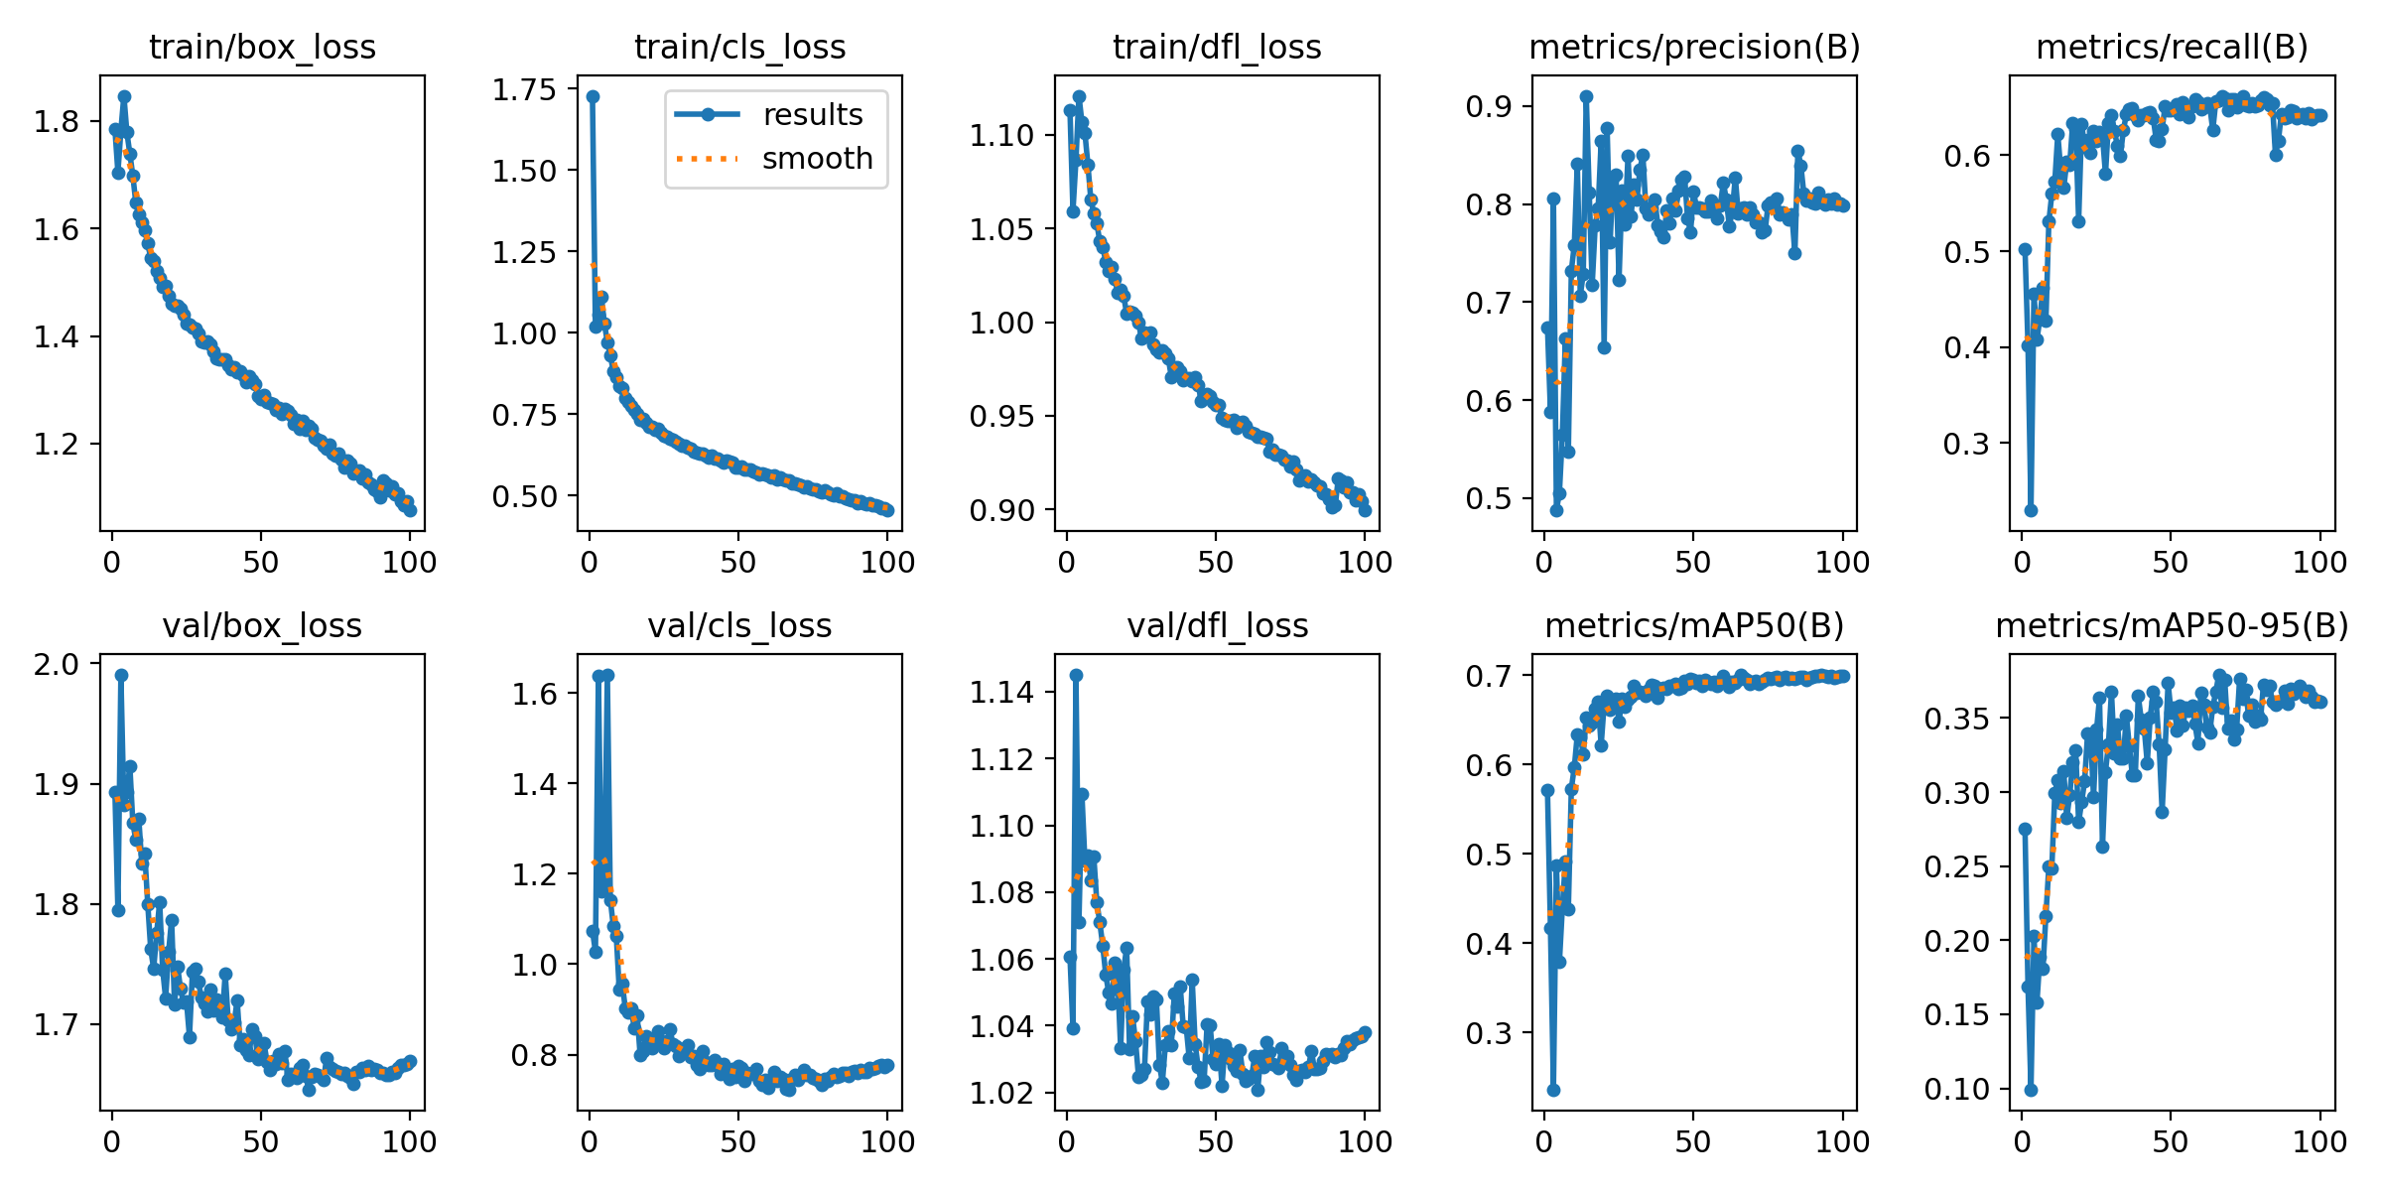
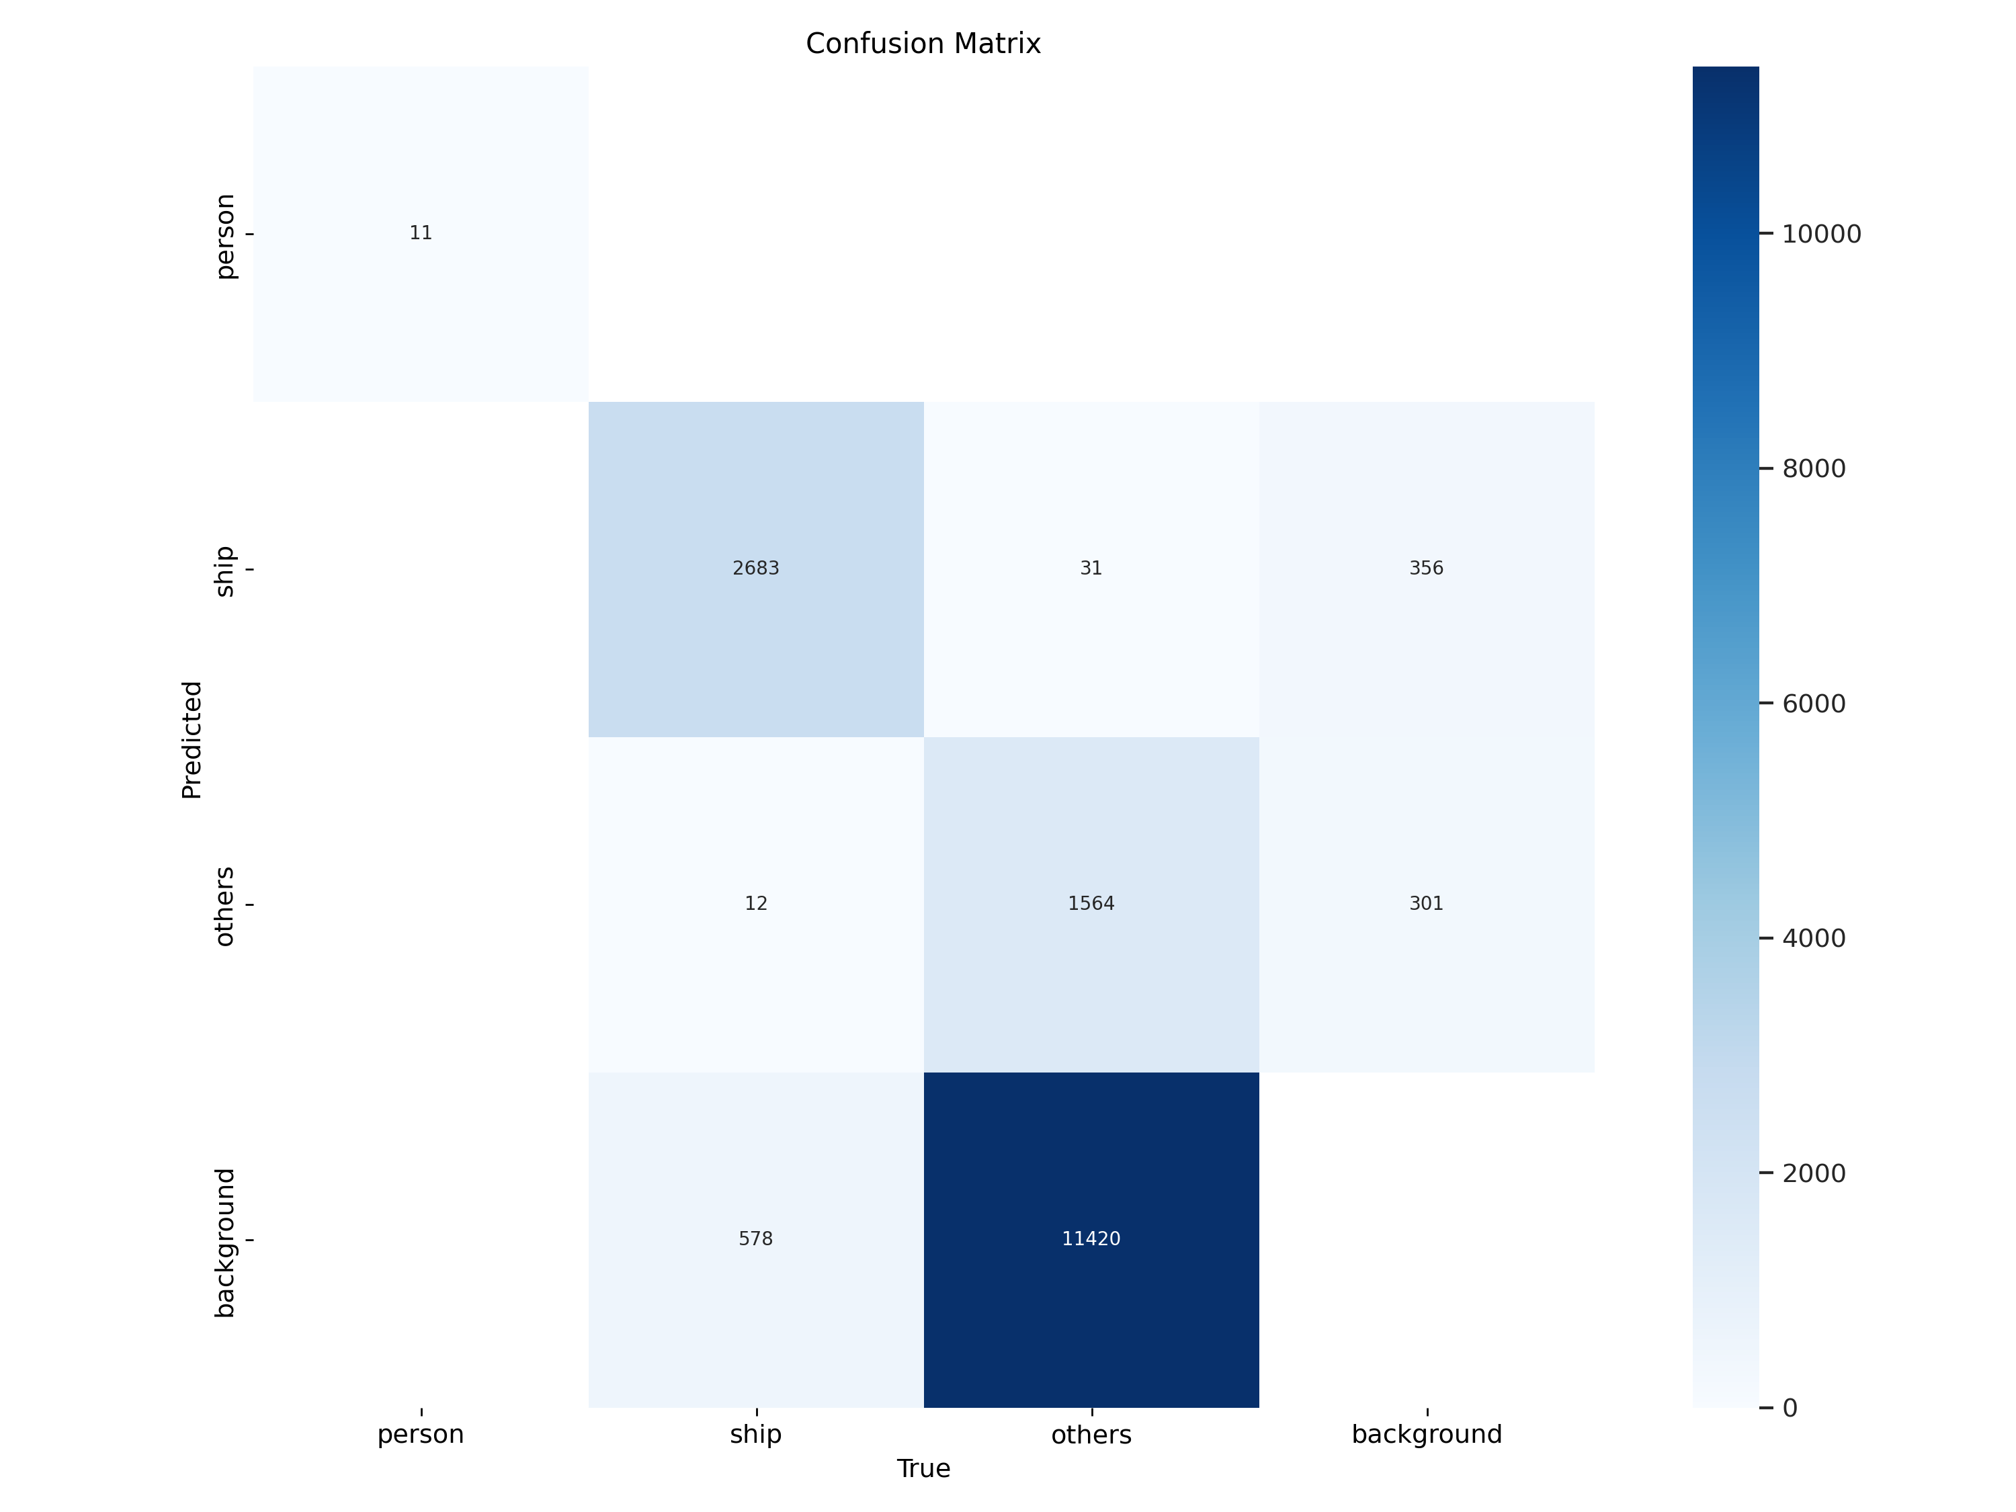
Results and Discussion
Fig. 13a: YOLOv8 Results

Slide 26
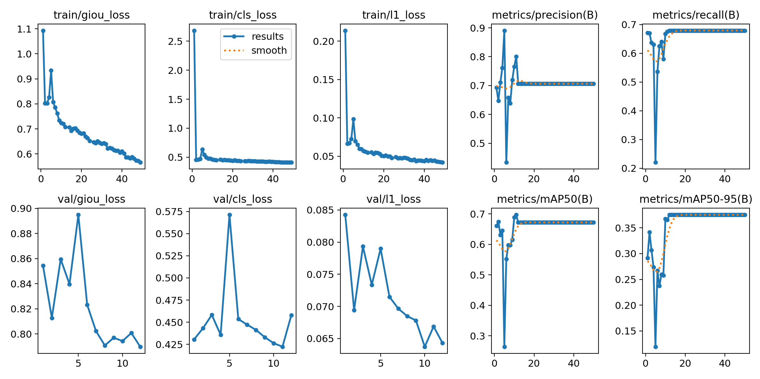
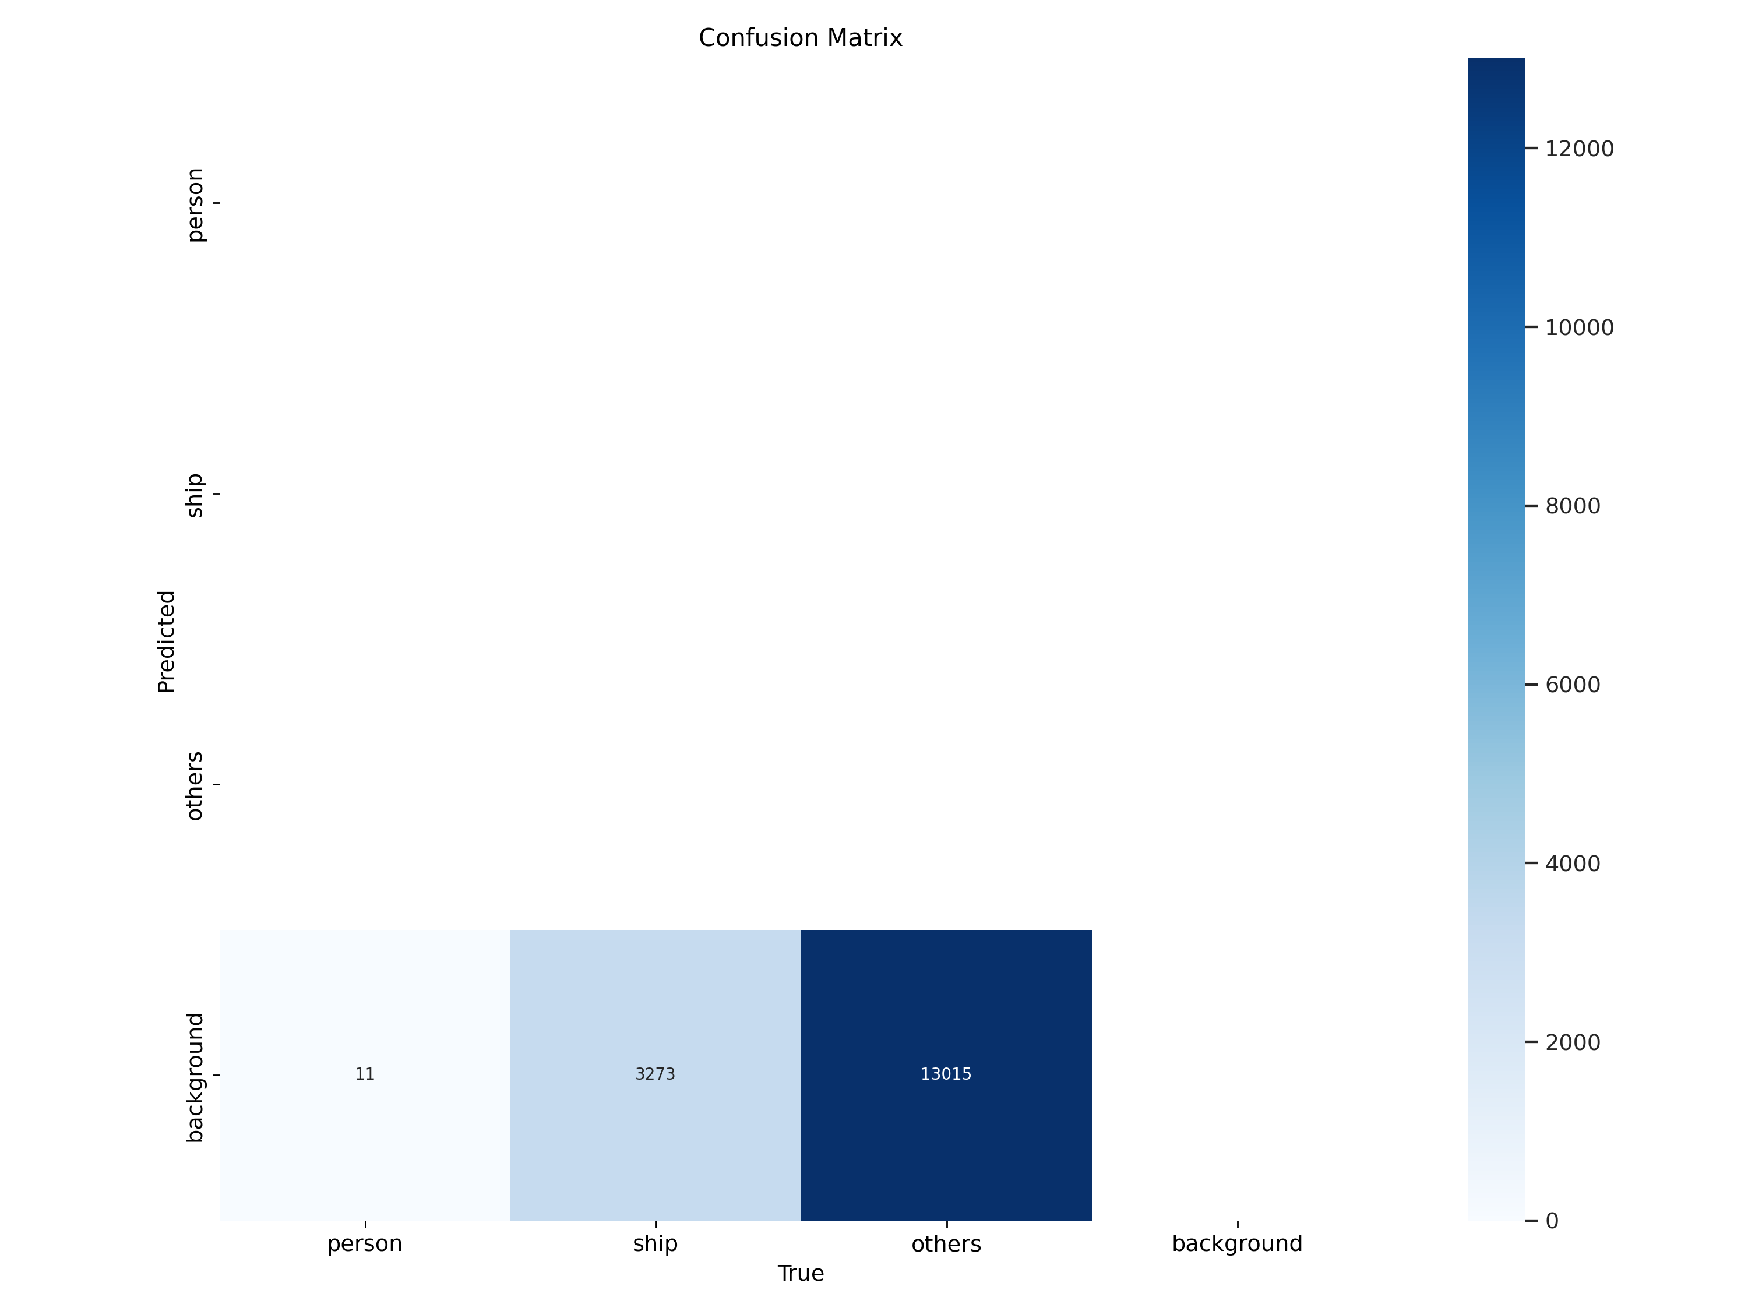
Results and Discussion
Fig. 13b: RT-DETR Results

Slide 27
Conclusion and Future Scope
The experimentation done with segmentation and detection models was successful.
MA-Net with EfficientNet backbone performed the best in semantic segmentation given that the model size was only 31M parameters.
The data from the IMU can be used to create horizon masks, which can then be used as a feature.
Sophisticated loss-functions can be used to increase water-obstacle separation.
YOLOv8 performed best in the detection task. However, it requires a lot of hyper-parameter tuning.
For further experimentation, models like SSD, FCOS, and YOLOX can be trained.

Slide 28
Conclusion and Future Scope
To check the real-time capabilities, models need to perform prediction on the embedded GPU.
depends heavily on the quantisation as well as the run-time used. For example – Nvidia DeepStream
Experimentation can also be performed for a unified model as we can use all the computation power of the GPUs.
Construction of an Indian dataset is extremely necessary

Slide 29
References
Title slide image Credits: https://www.oglemodels.com/case-studies/unmanned-surface-vessel/
Title slide image Credits: https://www.unmannedsystemstechnology.com/expo/autonomous-surface-vehicles-asv/
Heidarsson et al. (2011). Obstacle detection from overhead imagery using self-supervised learning for Autonomous Surface Vehicles. IEEE International Conference on Intelligent Robots and Systems. 3160-3165. 10.1109/IROS.2011.6048233.
Larson et al. (2007). Advances in Autonomous Obstacle Avoidance for Unmanned Surface Vehicles.
Gal, O. (2011). Automatic Obstacle Detection for USV’s Navigation Using Vision Sensors. In A.Schlaefer & O. Blaurock (Eds.), Robotic Sailing (pp. 127–140). Springer Berlin Heidelberg.
Wang et al. (2011). Real-time obstacle detection for Unmanned Surface Vehicle. 2011 Defense Science Research Conference and Expo (DSR)
Kristan et al. (2015). Fast image-based obstacle detection from unmanned surface vehicles.
Bovcon et al. (2018). Stereo obstacle detection for unmanned surface vehicles by IMU-assisted semantic segmentation. Robotics and Autonomous Systems, 104, 1–13.
Bovcon et al (2019). The MaSTr1325 dataset for training deep USV obstacle detection models. 2019 IEEE/RSJ International Conference on Intelligent Robots and Systems (IROS), 3431–3438.
Bovcon et al. (2022). MODS—A USV-Oriented Object Detection and Obstacle Segmentation Benchmark. IEEE Transactions on Intelligent Transportation Systems, 23(8),13403–13418.
Ahmed et al. (2023). Vision-Based Autonomous Navigation for Unmanned Surface Vessel in Extreme Marine Conditions.
Olaf Ronneberger, Philipp Fischer, Thomas Brox. "U-Net: Convolutional Networks for Biomedical Image Segmentation." (2015).

Slide 30
THANK YOU

